Slide 1
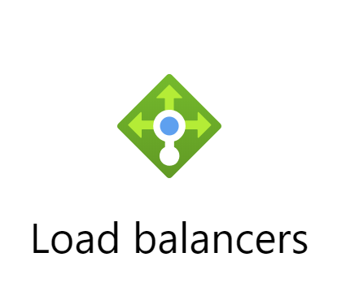
Presentation from 박 찬
Mail Address : chan157@naver.com
GitHub Address : https://github.com/chan157/TIL/
Phone Number : 010-4484-1251

Slide 2
Contents
Load Balancer Basic concept
How to use Load Balancer using PowerS
Question

Slide 3
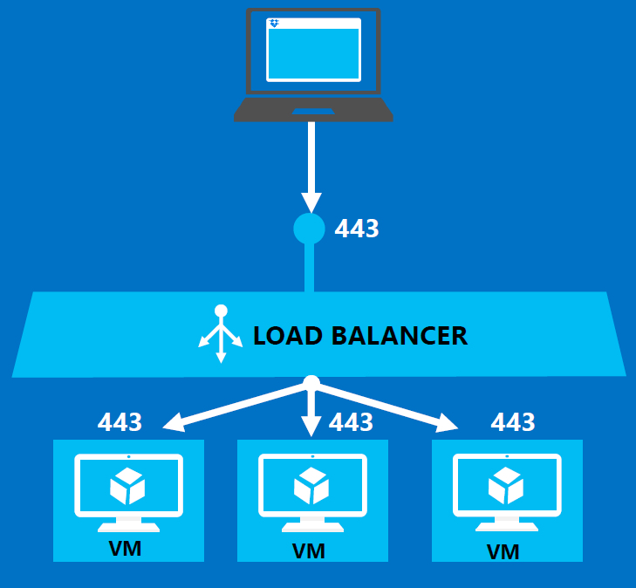
Load Balancer Basic
Laod Banacing
부하분산 또는 로드 밸런싱(load balancing)^{[1]}은 컴퓨터 네트워크 기술의 일종으로 둘 혹은 셋이상의 중앙처리장치 혹은 저장장치와 같은 컴퓨터 자원들에게 작업을 나누는 것을 의미한다. 이로써 가용성 및 응답시간을 최적화 시킬 수 있다

Slide 4
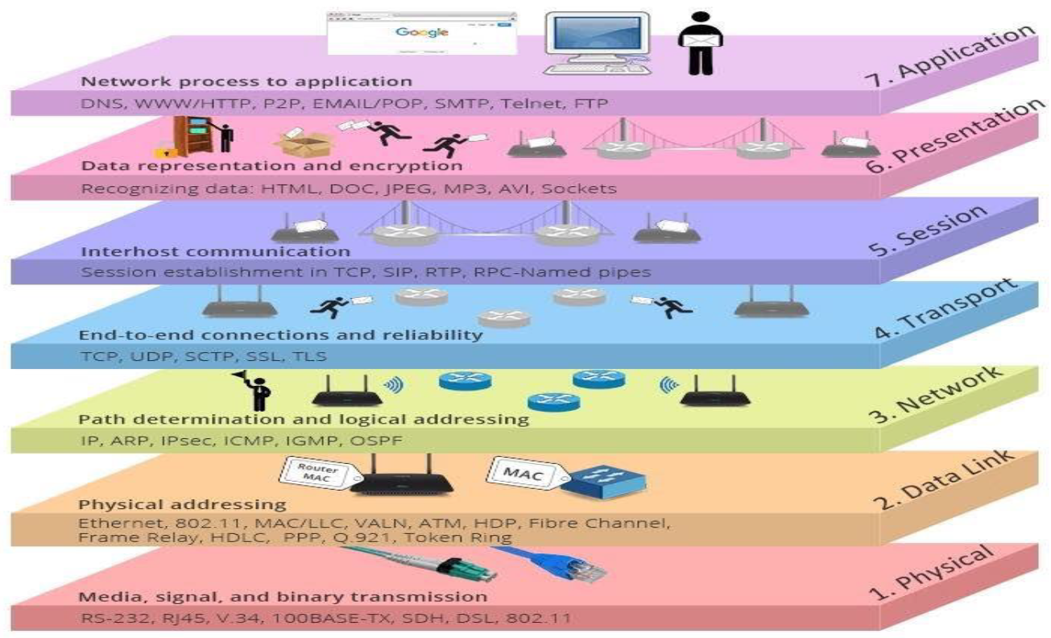
Load Balancer Basic
OSI 7 Layer

Slide 5
Load Balancer Basic
Traffic 분산
Load Balancer
Layer 4 Traffic 분산
Internal or internet-facing
같은 Data Center 내의 VM들 사이에서 부하 분산
Application Gateway
Layer 7 Traffic 분산
다른 Data Center 간의 VM들 사이에서도 부하 분산
Traffic Manager
DNS-based, Layer 7 Traffic 분산
Internet facing
공용 IP주소로 된 DNS를 기반으로 트래픽 분산

Slide 6
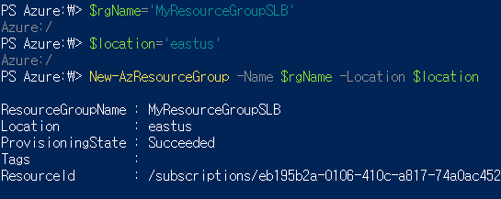
How to use Load Balancer using Powershell
1. Resource Group 생성
Notes:
$rgName='MyResourceGroupSLB'
$location='eastus'
New-AzResourceGroup -Name $rgName -Location $location

Slide 7
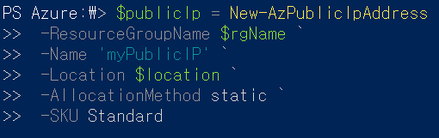
How to use Load Balancer using Powershell
2. Public IP 주소 생성
Notes:
$publicIp = New-AzPublicIpAddress `
-ResourceGroupName $rgName `
-Name 'myPublicIP' `
-Location $location `
-AllocationMethod static `
-SKU Standard

Slide 8
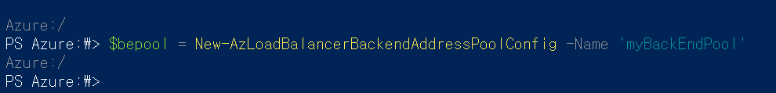
How to use Load Balancer using Powershell
3. Load Balancer 만들기
a. 프론트 엔드 IP만들기
Notes:
$feip = New-AzLoadBalancerFrontendIpConfig -Name 'myFrontEndPool' -PublicIpAddress $publicIp

Slide 9
How to use Load Balancer using Powershell
3. Load Balancer 만들기
b. Backend Address pool 구성하기
Notes:
$bepool = New-AzLoadBalancerBackendAddressPoolConfig -Name 'myBackEndPool'

Slide 10
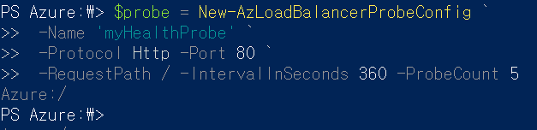
How to use Load Balancer using Powershell
3. Load Balancer 만들기
c. Probe 만들기
Notes:
$probe = New-AzLoadBalancerProbeConfig `
-Name 'myHealthProbe' `
-Protocol Http -Port 80 `
-RequestPath / -IntervalInSeconds 360 -ProbeCount 5

Slide 11
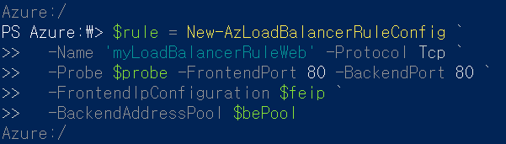
How to use Load Balancer using Powershell
3. Load Balancer 만들기
d. Load Balancing Rule 설정
Notes:
$rule = New-AzLoadBalancerRuleConfig `
-Name 'myLoadBalancerRuleWeb' -Protocol Tcp `
-Probe $probe -FrontendPort 80 -BackendPort 80 `
-FrontendIpConfiguration $feip `
-BackendAddressPool $bePool

Slide 12
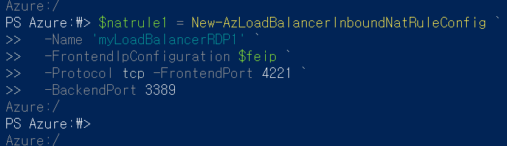
How to use Load Balancer using Powershell
3. Load Balancer 만들기
e. NAT Rule 설정
Notes:
$natrule1 = New-AzLoadBalancerInboundNatRuleConfig `
-Name 'myLoadBalancerRDP1' `
-FrontendIpConfiguration $feip `
-Protocol tcp -FrontendPort 4221 `
-BackendPort 3389
$natrule2 = New-AzLoadBalancerInboundNatRuleConfig `
-Name 'myLoadBalancerRDP2' `
-FrontendIpConfiguration $feip `
-Protocol tcp `
-FrontendPort 4222 `
-BackendPort 3389
$natrule3 = New-AzLoadBalancerInboundNatRuleConfig `
-Name 'myLoadBalancerRDP3' `
-FrontendIpConfiguration $feip `
-Protocol tcp `
-FrontendPort 4223 `
-BackendPort 3389

Slide 13
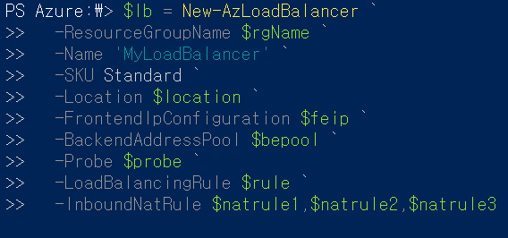
How to use Load Balancer using Powershell
3. Load Balancer 만들기
f. Load Balancer 생성
Notes:
$lb = New-AzLoadBalancer `
-ResourceGroupName $rgName `
-Name 'MyLoadBalancer' `
-SKU Standard `
-Location $location `
-FrontendIpConfiguration $feip `
-BackendAddressPool $bepool `
-Probe $probe `
-LoadBalancingRule $rule `
-InboundNatRule $natrule1,$natrule2,$natrule3

Slide 14

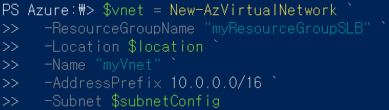
How to use Load Balancer using Powershell
4. Network Resource 생성
a. Virtual Network 생성
Notes:
# Create subnet config
$subnetConfig = New-AzVirtualNetworkSubnetConfig `
-Name "mySubnet" `
-AddressPrefix 10.0.2.0/24
# Create the virtual network
$vnet = New-AzVirtualNetwork `
-ResourceGroupName "myResourceGroupSLB" `
-Location $location `
-Name "myVnet" `
-AddressPrefix 10.0.0.0/16 `
-Subnet $subnetConfig

Slide 15
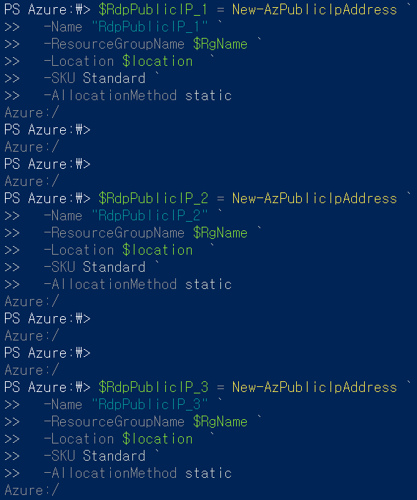
How to use Load Balancer using Powershell
4. Network Resource 생성
b. VM의 공용 IP 주소 생성
Notes:
$RdpPublicIP_1 = New-AzPublicIpAddress `
-Name "RdpPublicIP_1" `
-ResourceGroupName $RgName `
-Location $location `
-SKU Standard `
-AllocationMethod static
$RdpPublicIP_2 = New-AzPublicIpAddress `
-Name "RdpPublicIP_2" `
-ResourceGroupName $RgName `
-Location $location `
-SKU Standard `
-AllocationMethod static
$RdpPublicIP_3 = New-AzPublicIpAddress `
-Name "RdpPublicIP_3" `
-ResourceGroupName $RgName `
-Location $location `
-SKU Standard `
-AllocationMethod static

Slide 16
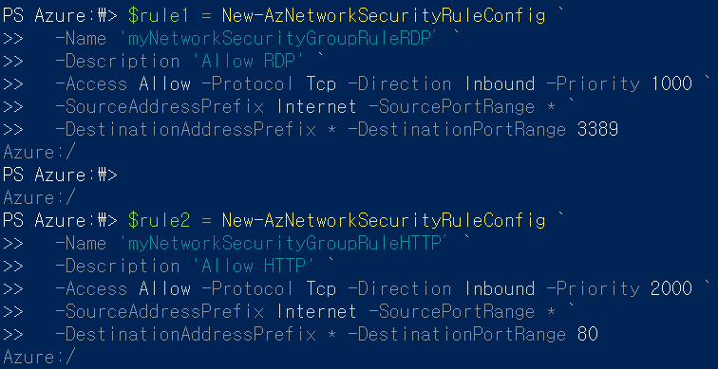
How to use Load Balancer using Powershell
4. Network Resource 생성
c. NSG Rule 생성 : TCP 3389, TCP 80 포트 열기
Notes:
$rule1 = New-AzNetworkSecurityRuleConfig `
-Name 'myNetworkSecurityGroupRuleRDP’ `
-Description 'Allow RDP' `
-Access Allow -Protocol Tcp -Direction Inbound -Priority 1000 `
-SourceAddressPrefix Internet -SourcePortRange * `
-DestinationAddressPrefix * -DestinationPortRange 3389
$rule2 = New-AzNetworkSecurityRuleConfig `
-Name 'myNetworkSecurityGroupRuleHTTP’ `
-Description 'Allow HTTP' `
-Access Allow -Protocol Tcp -Direction Inbound -Priority 2000 `
-SourceAddressPrefix Internet -SourcePortRange * `
-DestinationAddressPrefix * -DestinationPortRange 80

Slide 17
How to use Load Balancer using Powershell
4. Network Resource 생성
d. NSG 만들기
Notes:
$nsg = New-AzNetworkSecurityGroup -ResourceGroupName $RgName -Location $location `
-Name 'myNetworkSecurityGroup' -SecurityRules $rule1,$rule2

Slide 18
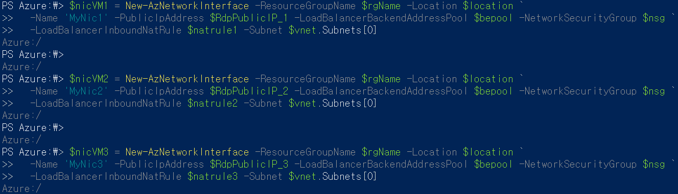
How to use Load Balancer using Powershell
5. NIC 생성
Notes:
# Create NIC for VM1
$nicVM1 = New-AzNetworkInterface -ResourceGroupName $rgName -Location $location `
-Name 'MyNic1' -PublicIpAddress $RdpPublicIP_1 -LoadBalancerBackendAddressPool $bepool -NetworkSecurityGroup $nsg `
-LoadBalancerInboundNatRule $natrule1 -Subnet $vnet.Subnets[0]
$nicVM2 = New-AzNetworkInterface -ResourceGroupName $rgName -Location $location `
-Name 'MyNic2' -PublicIpAddress $RdpPublicIP_2 -LoadBalancerBackendAddressPool $bepool -NetworkSecurityGroup $nsg `
-LoadBalancerInboundNatRule $natrule2 -Subnet $vnet.Subnets[0]
$nicVM3 = New-AzNetworkInterface -ResourceGroupName $rgName -Location $location `
-Name 'MyNic3' -PublicIpAddress $RdpPublicIP_3 -LoadBalancerBackendAddressPool $bepool -NetworkSecurityGroup $nsg `
-LoadBalancerInboundNatRule $natrule3 -Subnet $vnet.Subnets[0]

Slide 19
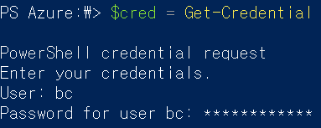
How to use Load Balancer using Powershell
6. Virtual Machine 만들기
a. 계정 생성
Notes:
$cred = Get-Credential
# ############## VM1 ###############
# Create a virtual machine configuration
$vmConfig = New-AzVMConfig -VMName 'myVM1' -VMSize Standard_DS1_v2 `
| Set-AzVMOperatingSystem -Windows -ComputerName 'myVM1' -Credential $cred `
| Set-AzVMSourceImage -PublisherName MicrosoftWindowsServer -Offer WindowsServer -Skus 2019-Datacenter -Version latest `
| Add-AzVMNetworkInterface -Id $nicVM1.Id
# Create a virtual machine
$vm1 = New-AzVM -ResourceGroupName $rgName -Zone 1 -Location $location -VM $vmConfig
# ############## VM2 ###############
# Create a virtual machine configuration
$vmConfig = New-AzVMConfig -VMName 'myVM2' -VMSize Standard_DS1_v2 `
| Set-AzVMOperatingSystem -Windows -ComputerName 'myVM2' -Credential $cred `
| Set-AzVMSourceImage -PublisherName MicrosoftWindowsServer -Offer WindowsServer -Skus 2019-Datacenter -Version latest `
| Add-AzVMNetworkInterface -Id $nicVM2.Id
# Create a virtual machine
$vm2 = New-AzVM -ResourceGroupName $rgName -Zone 2 -Location $location -VM $vmConfig
# ############## VM3 ###############
# Create a virtual machine configuration
$vmConfig = New-AzVMConfig -VMName 'myVM3' -VMSize Standard_DS1_v2 `
| Set-AzVMOperatingSystem -Windows -ComputerName 'myVM3' -Credential $cred `
| Set-AzVMSourceImage -PublisherName MicrosoftWindowsServer -Offer WindowsServer -Skus 2019-Datacenter -Version latest `
| Add-AzVMNetworkInterface -Id $nicVM3.Id
# Create a virtual machine
$vm3 = New-AzVM -ResourceGroupName $rgName -Zone 3 -Location $location -VM $vmConfig

Slide 20
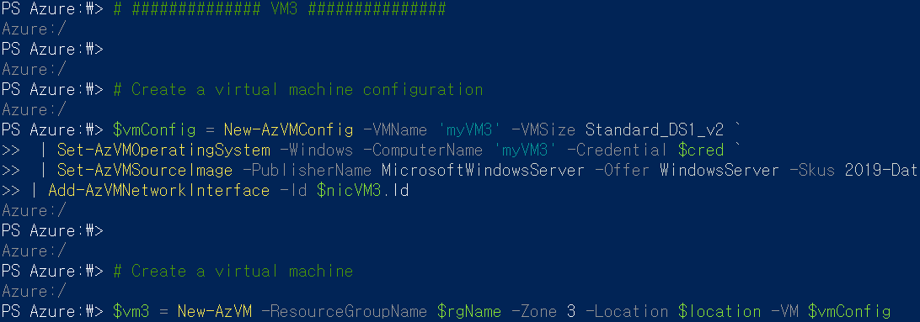
How to use Load Balancer using Powershell
6. Virtual Machine 만들기
b. VM 생성
Notes:
$cred = Get-Credential
# ############## VM1 ###############
# Create a virtual machine configuration
$vmConfig = New-AzVMConfig -VMName 'myVM1' -VMSize Standard_DS1_v2 `
| Set-AzVMOperatingSystem -Windows -ComputerName 'myVM1' -Credential $cred `
| Set-AzVMSourceImage -PublisherName MicrosoftWindowsServer -Offer WindowsServer -Skus 2019-Datacenter -Version latest `
| Add-AzVMNetworkInterface -Id $nicVM1.Id
# Create a virtual machine
$vm1 = New-AzVM -ResourceGroupName $rgName -Zone 1 -Location $location -VM $vmConfig
# ############## VM2 ###############
# Create a virtual machine configuration
$vmConfig = New-AzVMConfig -VMName 'myVM2' -VMSize Standard_DS1_v2 `
| Set-AzVMOperatingSystem -Windows -ComputerName 'myVM2' -Credential $cred `
| Set-AzVMSourceImage -PublisherName MicrosoftWindowsServer -Offer WindowsServer -Skus 2019-Datacenter -Version latest `
| Add-AzVMNetworkInterface -Id $nicVM2.Id
# Create a virtual machine
$vm2 = New-AzVM -ResourceGroupName $rgName -Zone 2 -Location $location -VM $vmConfig
# ############## VM3 ###############
# Create a virtual machine configuration
$vmConfig = New-AzVMConfig -VMName 'myVM3' -VMSize Standard_DS1_v2 `
| Set-AzVMOperatingSystem -Windows -ComputerName 'myVM3' -Credential $cred `
| Set-AzVMSourceImage -PublisherName MicrosoftWindowsServer -Offer WindowsServer -Skus 2019-Datacenter -Version latest `
| Add-AzVMNetworkInterface -Id $nicVM3.Id
# Create a virtual machine
$vm3 = New-AzVM -ResourceGroupName $rgName -Zone 3 -Location $location -VM $vmConfig

Slide 21
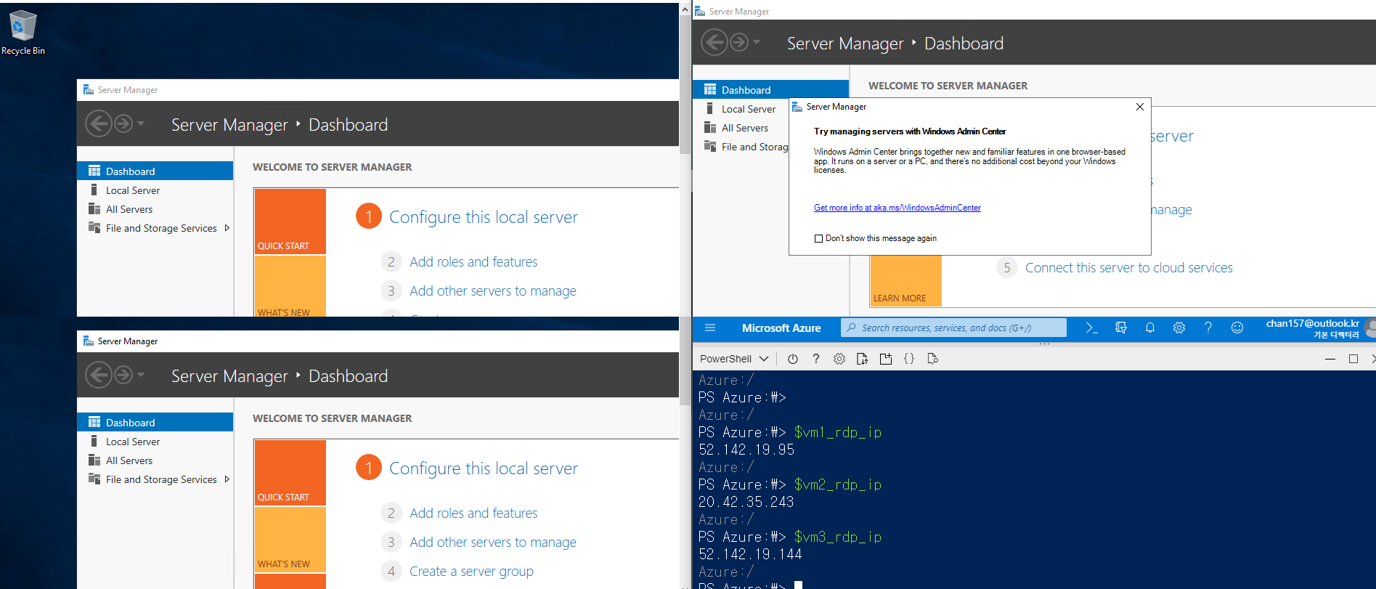
How to use Load Balancer using Powershell
7. VM 접속
Notes:
$vm1_rdp_ip = (Get-AzPublicIPAddress -ResourceGroupName $rgName -Name "RdpPublicIP_1").IpAddress
$vm2_rdp_ip = (Get-AzPublicIPAddress -ResourceGroupName $rgName -Name "RdpPublicIP_2").IpAddress
$vm3_rdp_ip = (Get-AzPublicIPAddress -ResourceGroupName $rgName -Name "RdpPublicIP_3").IpAddress
mstsc /v $vm1_rdp_ip

Slide 22
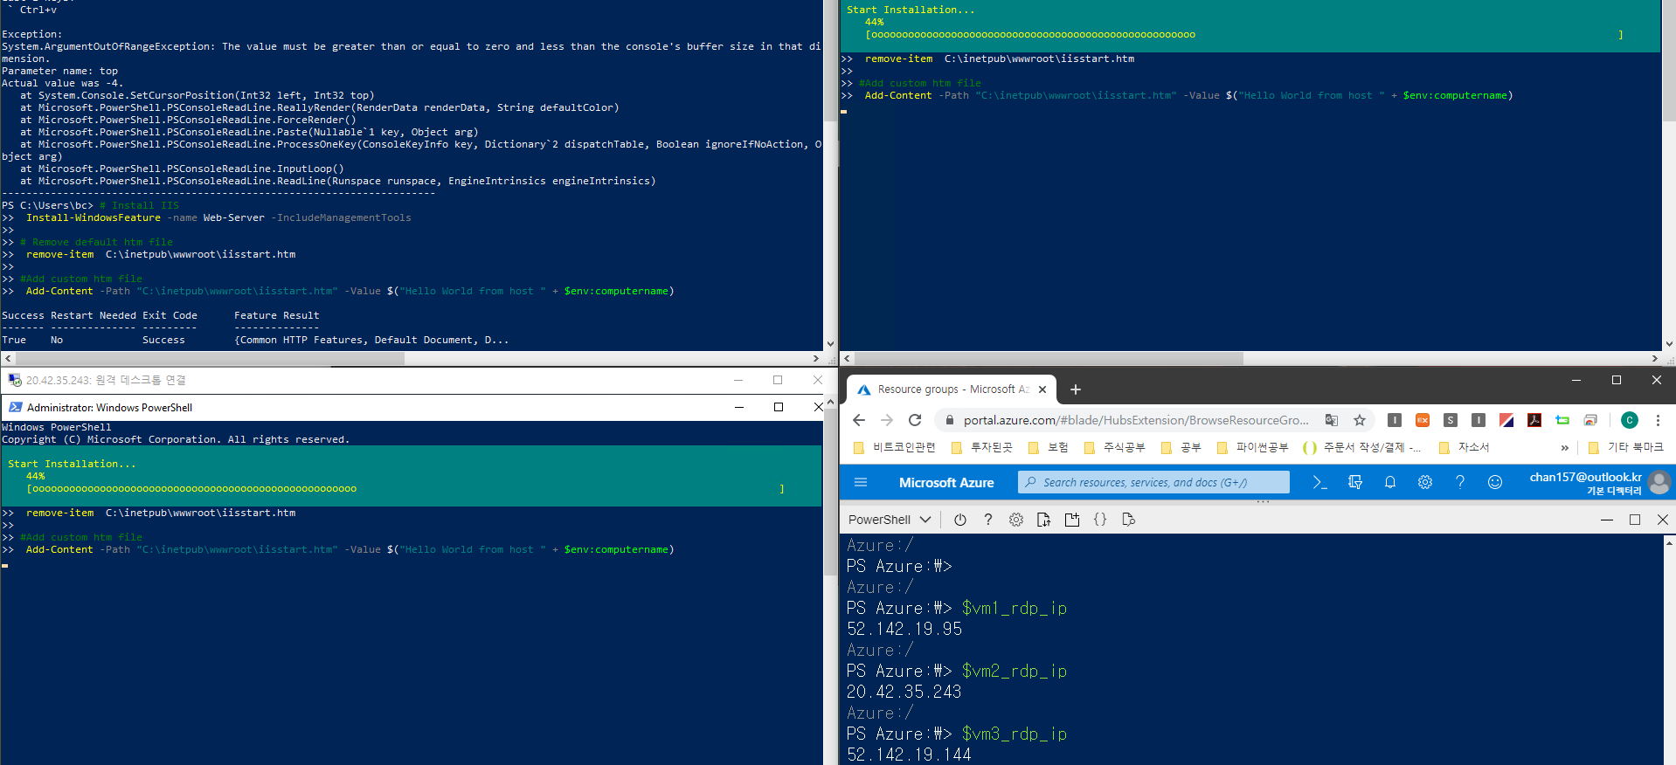
How to use Load Balancer using Powershell
8. IIS 서버 설치
Notes:
$vm1_rdp_ip = (Get-AzPublicIPAddress -ResourceGroupName $rgName -Name "RdpPublicIP_1").IpAddress
$vm2_rdp_ip = (Get-AzPublicIPAddress -ResourceGroupName $rgName -Name "RdpPublicIP_2").IpAddress
$vm3_rdp_ip = (Get-AzPublicIPAddress -ResourceGroupName $rgName -Name "RdpPublicIP_3").IpAddress

Slide 23
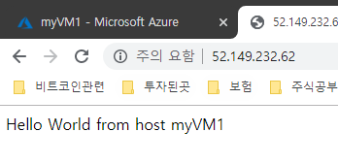
How to use Load Balancer using Powershell
8. Load Balance 동작 확인
a. Frontend 공용 IP를 통해 인터넷에 접속
Notes:
$vm1_rdp_ip = (Get-AzPublicIPAddress -ResourceGroupName $rgName -Name "RdpPublicIP_1").IpAddress
$vm2_rdp_ip = (Get-AzPublicIPAddress -ResourceGroupName $rgName -Name "RdpPublicIP_2").IpAddress
$vm3_rdp_ip = (Get-AzPublicIPAddress -ResourceGroupName $rgName -Name "RdpPublicIP_3").IpAddress

Slide 24
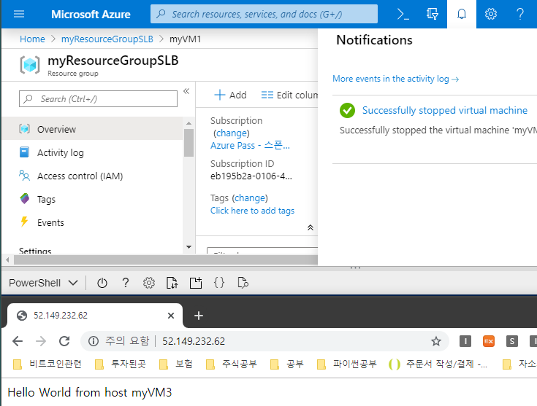
How to use Load Balancer using Powershell
8. Load Balance 동작 확인
a. VM1을 동작 중지 후 재접속

Slide 25

Question

